Slide 1
Data Types
Unit 1

Slide 2
2.1 Introduction
Before writing a program
Have a thorough understanding of problem
Carefully plan your approach for solving it
While writing a program
Know what “building blocks” are available
Use good programming principles

Slide 3
Overview
Explain algorithms and the key features of an algorithm— sequence, decision, and repetition.
Learn the different ways of stating algorithms—step-form, flowchart, etc.
Define variables, types of variables, and naming conventions for variables.
Decide a strategy for designing algorithms.
Explain the concept of tracing the correctness of an algorithm
Discuss the method of implementing an algorithm in a Program
Explain structural programming and the process of programming

Slide 4
Key Words
Important Terms
Algorithm: An algorithm specifies a procedure for solving a problem in a finite number of steps.
Correctness: Correctness means how easily its logic can be argued to meet the algorithm’s primary goal.
Data: It is a symbolic representation of value.
Debug: It means to search and remove errors in a program.
High-level programming language :A language similar to human languages that makes it easy for a programmer to write programs and identify and correct errors in them.
Investigation step: It is a step to determine the input, output and processing requirements of a problem.

Slide 5
Key Words
Low-level programming language :Closer to the native language of the computer, which is 1’s and 0’s.
Machine language : Machine language is a language that provides instructions in the form of binary numbers consisting of 1’s and 0’s to which the computer responds directly.
Portability of language: A programming language that is not machine dependent and can be used in any computer.
Program :A set of logically related instructions arranged in a sequence that directs the computer in solving a problem.

Slide 6
Key Words
Programming language: A language composed of a set of instructions understandable by the programmer.
Programming: It is a process of writing a program.
Termination: It denotes closure of a procedure.
Top-down analysis : It means breaking up a problem solution into smaller modules and defining their interconnections to provide the total solution to a problem.
Variable: It is a container or storage location for storing a value that may or may not vary during the execution of the program.

Slide 7
Algorithms
To solve any problem a plan is needed. This plan is a procedure to solve the problem in question.
The procedure has to be based on definite reasoning and logic to obtain a result.
A well-designed algorithm will always provide an answer; it may not be the desired answer but there will be an answer.
A well-designed algorithm is also guaranteed to terminate.

Slide 8
What is an Algorithm?
Computer scientist Niklaus Wirth stated that , Program = Algorithms + Data
An algorithm is a part of the plan for the computer program. In fact, an algorithm is ‘an effective procedure for solving a problem in a finite number of steps’.
It is effective, which means that an answer is found and it has a finite number of steps.

Slide 9
Different Ways of Stating Algorithms
Algorithms may be represented in various ways. The four common ways of representing an algorithm are as follows:
Step-form
Pseudo-code
Flowchart
Nassi-Schneiderman

Slide 10
Key Features: Algorithm & Step form
Here is an example of an algorithm, for making a pot of tea.
1. If the kettle does not contain water, then fill the kettle.
2. Plug the kettle into the power point and switch it on.
3. If the teapot is not empty, then empty the teapot.
4. Place tea leaves in the teapot.
5. If the water in the kettle is not boiling, then go to step 5.
6. Switch off the kettle.
7. Pour water from the kettle into the teapot.
From this example, it is evident that algorithms show these three features:
Sequence (also known as process)
Decision (also known as selection)
Repetition (also known as iteration or looping)

Slide 11
Sequence
Sequence means that each step or process in the algorithm is executed in the specified order. In the above example, each process must be in the proper place otherwise the algorithm will fail.
The decision constructs—if ... then, if ... then ... else...
if proposition
then process1
else process2
This is the if … then … else … form of the decision. This means that if the proposition is true then execute process1, else, or otherwise, execute process2.

Slide 12
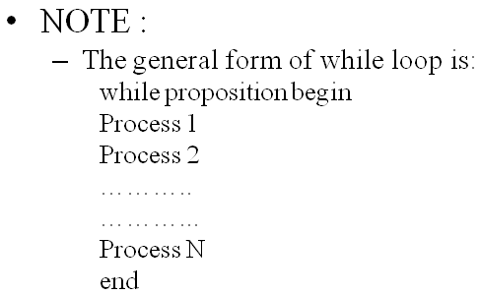
Repetition constructs : repeat & while
Repetition can be implemented using constructs like the repeat loop, while loop, and if.. then .. goto .. Loop.
The Repeat loop is used to iterate or repeat a process or sequence of processes until some condition becomes true.
Repeat
Process1
Process2
..........
………..
ProcessN
Until proposition

Slide 13
Correctness
The prepared algorithm needs to be verified for its correctness.
Correctness means how easily its logic can be argued to satisfy the algorithm’s primary goal.
Correctness is the degree to which an algorithm performs its specified function.
The most common measure of correctness is defects per Kilo Lines of Code (KLOC) that implements the algorithm, where defect is defined as the verified lack of conformance to requirements.
This requires the algorithm to be made in such a way that all the elements in it are traceable to the requirements.

Slide 14
Variables & Data types
The data used in algorithms can be of different types. The simplest types of data that an algorithm might use are
numeric data, e.g., 12, 11.45, 901, etc.
alphabetic or character data such as ‘A’, ‘Z’, or ‘This is alphabetic’.
logical data, that is, propositions with true/false values.
Naming of variables
One should always try to choose meaningful names for variables in algorithms to improve the readability of the algorithm or program. This is particularly important in large and complex programs.
Data is a symbolic representation of value.
A variable, which has a name, is a container for a value that may vary during the execution of the program.

Slide 15
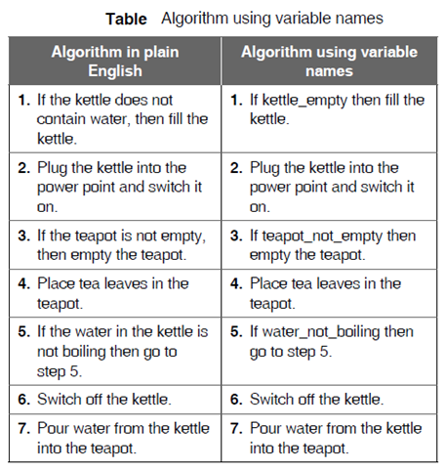
An Example

Slide 16
Subroutines
A subroutine is a logical collection of instructions that is invoked from within a larger program to perform a specific task.
The subroutine is relatively independent of the remaining statements of the program that invokes it.
A subroutine can be invoked several times from several places during a single execution of the invoking program.
After completing the specific task, a subroutine returns to the point of invocation in the larger program.

Slide 17
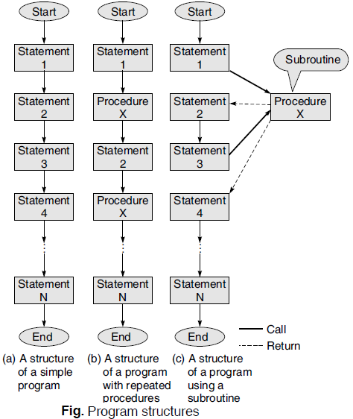
Program Structure

Slide 18
Examples : Developing algorithms using step-form
For illustrating the step-form the following conventions are assumed:
Each algorithm will be logically enclosed by two statements START and STOP.
To accept data from user, the INPUT or READ statements are to be used.
To display any user message or the content in a variable, PRINT statement will be used. Note that the message will be enclosed within quotes.
There are several steps in an algorithm. Each step results in an action. The steps are to be acted upon sequentially in the order they are arranged or directed.

Slide 19
Examples : Developing algorithms using step-form
5. The arithmetic operators that will be used in the expressions are
(i) ‘←’ ….Assignment (the left-hand side of ‘←’ should always be a single variable)
(ii) ‘+’….. Addition
(iii) ‘–’….. Subtraction
(iv) ‘*’….. Multiplication
(v) ‘/’….. Division
6. In propositions, the commonly used relational operators will include
(i) ‘>’ ….. Greater than
(ii) ‘<=’ …..Less than or equal to
(iii) ‘<’ …… Less than
(iv) ‘=’ …… Equality
(v) ‘>=’ …… Greater than or equal to
(vi) ‘!=’ …… Non- equality

Slide 20
Examples : Developing algorithms using step-form
The most commonly used logical operators will be AND, OR and NOT. These operators are used to specify multiple test conditions forming composite proposition. These are
(i) ‘AND’…… Conjunction
(ii) ‘OR’ …… Disjunction
(iii) ‘NOT’ …… Negation

Slide 21
2.3 Pseudocode
Pseudocode
Artificial, informal language used to develop algorithms
Similar to everyday English
Not executed on computers
Used to think out program before coding
Easy to convert into C++ program
Only executable statements
No need to declare variables

Slide 22
Pseudo-code
Like step-form, Pseudo-code is a written statement of an algorithm using a restricted and well-defined vocabulary.
It is similar to a 3GL, and for many programmers and program designers it is the preferred way to state algorithms and program specifications.
Although there is no standard for pseudo-code, it is generally quite easy to read and use.
For instance, a sample pseudo- code is written as follows:
dowhile kettle_empty
Add_Water_To_Kettle
end dowhile

Slide 23
Flowcharts
A flowchart depicts appropriate steps to be followed in order to arrive at the solution to a problem.
It is a program design tool which is used before writing the actual program.
Guidelines for drawing a flowchart :
Flowcharts are usually drawn using standard symbols; however, some special symbols can also be developed when required.

Slide 24
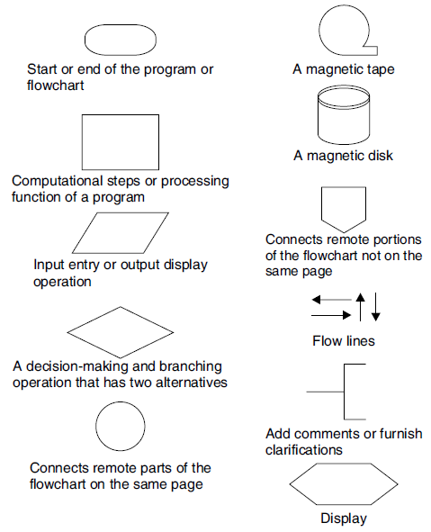
Flow Chart Symbol

Slide 25
Standards for Flowcharts
The following standards should be adhered to while drawing flow charts.
Flowcharts must be drawn on white, unlined 8½￠￠ × 11￠￠ paper, on one side only.
Flowcharts start on the top of the page and flow down and to the right.
Only standard flowcharting symbols should be used.
A template to draw the final version of flowchart should be used.
The contents of each symbol should be printed legibly.
English should be used in flowcharts, not programming language.
The flowchart for each subroutine, if any, must appear on a separate page. Each subroutine begins with a terminal symbol with the subroutine name and a terminal symbol labelled return at the end.
Draw arrows between symbols with a straight edge and use arrowheads to indicate the direction of the logic flow.

Slide 26
Advantages of Using Flowcharts
Communication: Flowcharts are a better way of communicating the logic of a system to all concerned.
Effective analysis: With the help of flowcharts, problems can be analysed more effectively.
Proper documentation: Program flowcharts serve as a good program documentation needed for various purposes.
Efficient coding: Flowcharts act as a guide or blueprint during the systems analysis and program development phase.
Proper debugging: Flowcharts help in the debugging process.
Efficient program maintenance : The maintenance of an operating program becomes easy with the help of a flowchart.

Slide 27
Limitations of using flowcharts
Complex logic: Sometimes, the program logic is quite complicated. In such a case, a flowchart becomes complex and clumsy.
Alterations and modifications : If alterations are required, the flowchart may need to be redrawn completely.
Reproduction : Since the flowchart symbols cannot be typed in, the reproduction of a flowchart becomes a problem.
Loss of objective: The essentials of what has to be done can easily be lost in the technical details of how it is to be done.

Slide 28
2.2 Algorithms
Computing problems
Solved by executing a series of actions in a specific order
Algorithm is a procedure determining
Actions to be executed
Order to be executed
Example: recipe
Program control
Specifies the order in which statements are executed

Slide 29
Strategy : Designing Algorithms
Investigation step
1. Identify the outputs needed.
2. Identify the input variables available.
3. Identify the major decisions and conditions.
4. Identify the processes required to transform inputs into required outputs.
5. Identify the environment available.
Top–down development step
1. Devise the overall problem solution by identifying the major components of the system.
2. Verify the feasibility of breaking up the overall problem solution.

Slide 30
Strategy : Designing Algorithms
Stepwise refinement
1. Work out each and every detail for each small piece of manageable solution procedure.
2. Decompose any solution procedure into further smaller pieces and iterate until the desired level of detail is achieved.
3. Group processes together which have some commonality.
4. Group variables together which have some appropriate commonality.
5. Test each small procedure for its detail and correctness and its interfacing with the other small procedures.

Slide 31
Tracing an Algorithm to Depict Logic
An algorithm is a collection of some procedural steps that have some precedence relation between them.
Certain procedures may have to be performed before some others are performed.
Hence, an algorithm is a collection of procedures that results in providing a solution to a problem.
Tracing an algorithm primarily involves tracking the outcome of every procedure in the order they are placed.
Tracking in turn means verifying every procedure one by one to determine and confirm the corresponding result that is to be obtained.

Slide 32
Convert: Algorithms into Programs
Once the algorithm, for solution of a problem, is formed and represented using any of the tools like step-form or flowchart or pseudo code, etc., it has to be transformed into some programming language code.
This means that a program, in a programming language, has to be written to represent the algorithm that provides a solution to a problem.
The general procedure to convert an algorithm into a program is given as follows:
Code the algorithm into a program
Desk-check the program
Evaluate and modify, if necessary, the program
Do not reinvent the wheel

Slide 33
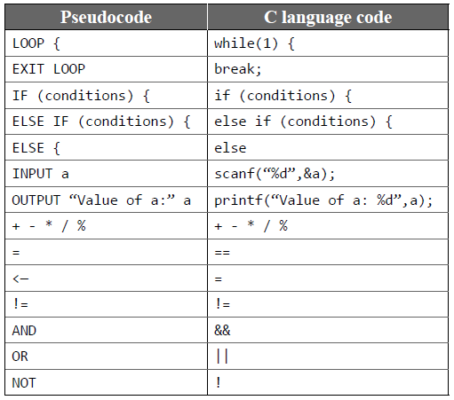
Pseudo code → C language

Slide 34
Structured Programming Concept
Structured programming is:
Concerned with improving the programming process through better organization of programs and better programming notation to facilitate correct and clear description of data and control structure.
Concerned with improved programming languages and organized programming techniques which should be understandable and therefore, more easily modifiable and suitable for documentation.
More economical to run because good organization and notation make it easier for an optimizing compiler to understand the program logic.
More correct and therefore more easily debugged, because general correctness theorems dealing with structures can be applied to prove the correctness of programs.

Slide 35
Structured Programming Concept
In 1968, computer scientist Edsger Dijkstra of Netherlands published a letter to the editor in the journal of the Association of Computing Machinery with the title ‘GoTo statement considered harmful’.
For three decades, Dijkstra had been crusading for a better way of programming—a systematic way to organize programs—called structured programming.
Structured programming can be defined as a
top–down analysis for program solving
modularization for program structure and organization
structured code for individual modules

Slide 36
Top Down Analysis
Top-down analysis is a method of problem solving and problem analysis.
The essential idea is to subdivide a large problem into several smaller tasks or parts for ease of analysis.
Top-down analysis, therefore, simplifies or reduces the complexity of the process of problem solving.
It is not limited by the type of program. Top-down analysis is a general method for attending to any problem.
It provides a strategy that has to be followed for solving all problems.
There are two essential ideas in top-down analysis:
subdivision of a problem
hierarchy of tasks

Slide 37
Modular Programming
Modular programming is a program that is divided into logically independent smaller sections, which can be written separately.
These sections, being separate and independent units, are called modules.
A module consists of a series of program instructions or statements in some programming language.
A module is clearly terminated by some special markers required by the syntax of the language. For example, a BASIC language subroutine is terminated by the return statement.
A module as a whole has a unique name.
A module has only one entry point to which control is transferred from the outside and only one exit point from which control is returned to the calling module. The following are some of the advantages of modular programming.
Complex programs may be divided into simpler and more manageable elements.

Slide 38
Structured Code
After the top-down analysis and design of the modular structure, the third and final phase of structured programming involves the use of structured code.
Structured programming is a method of coding, i.e., writing a program that produces a well-organized module.
A high-level language supports several control statements, also called structured control statements or structured code, to produce a well-organized structured module.

Slide 39
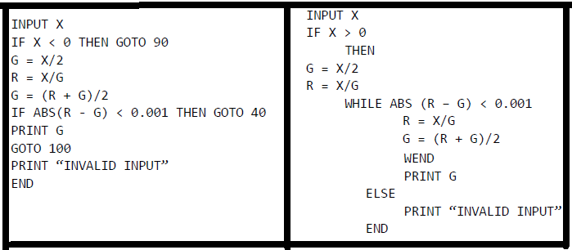
The structured version →using while-wend statement
The following example is a demonstration of a program using several goto statements. Note that at line numbers 20, 60, and 80, the normal flow control is broken. For example, from line number 60, control goes back to line 40 instead of line 70 in case value of (R – G) is less than 0.001.

Slide 40
The Process of Programming
There are some logical and sequential job steps which the programmer has to follow to make the program operational.
These are as follows:
1. Understand the problem to be solved
2. Think and design the solution logic
3. Write the program in the chosen programming language
4. Translate the program to machine code
5. Test the program with sample data
6. Put the program into operation

Slide 41
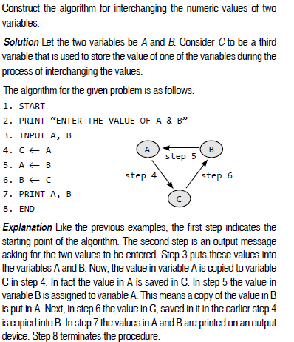
Example

Slide 42
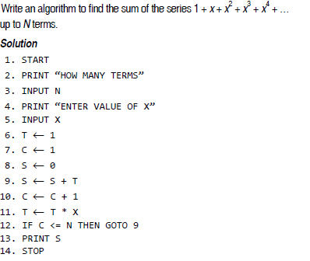
Example

Slide 43
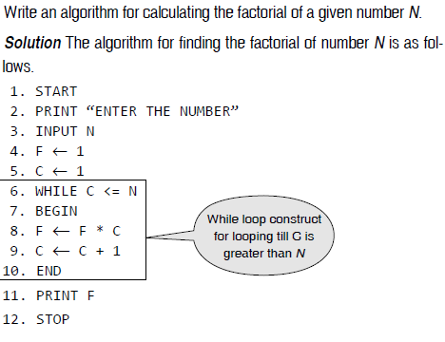
Example

Slide 44
Prepare a flowchart to read the marks of a student and classify them into different grades. If the marks secured are greater than or equal to 90, the student is awarded Grade A; if they are greater than or equal to 80 but less than 90, Grade B is awarded; if they are greater than or equal to 65 but less than 80, Grade C is awarded; otherwise Grade D is awarded.
Activity

Slide 45
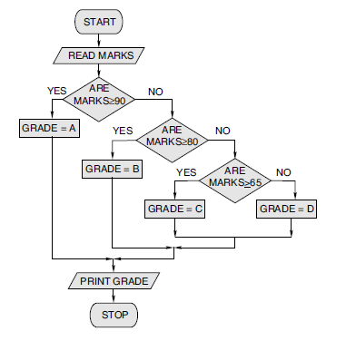

Slide 46
Data types in C
Only really four basic types:
char
int (short, long, long long, unsigned)
float
double
Size of these types on
CLEAR machines:
Sizes of these types
vary from one machine
to another!
Type | Size (bytes)
char | 1
int | 4
short | 2
long | 8
long long | 8
float | 4
double | 8

Slide 47
Characters (char)
Roman alphabet, punctuation, digits, and other symbols:
Encoded within one byte (256 possible symbols)
ASCII encoding (man ascii for details)
In C:
char a_char = ’a’;
char newline_char = ’\n’;
char tab_char = ’\t’;
char backslash_char = ’\\’;

Slide 48
ASCII
Special control characters
From “man ascii”:
| 0 NUL| 1 SOH| 2 STX| 3 ETX| 4 EOT| 5 ENQ| 6 ACK| 7 BEL|
| 8 BS | 9 HT | 10 NL | 11 VT | 12 NP | 13 CR | 14 SO | 15 SI |
| 16 DLE| 17 DC1| 18 DC2| 19 DC3| 20 DC4| 21 NAK| 22 SYN| 23 ETB|
| 24 CAN| 25 EM | 26 SUB| 27 ESC| 28 FS | 29 GS | 30 RS | 31 US |
| 32 SP | 33 ! | 34 " | 35 # | 36 $ | 37 % | 38 & | 39 ' |
| 40 ( | 41 ) | 42 * | 43 + | 44 , | 45 - | 46 . | 47 / |
| 48 0 | 49 1 | 50 2 | 51 3 | 52 4 | 53 5 | 54 6 | 55 7 |
| 56 8 | 57 9 | 58 : | 59 ; | 60 < | 61 = | 62 > | 63 ? |
| 64 @ | 65 A | 66 B | 67 C | 68 D | 69 E | 70 F | 71 G |
| 72 H | 73 I | 74 J | 75 K | 76 L | 77 M | 78 N | 79 O |
| 80 P | 81 Q | 82 R | 83 S | 84 T | 85 U | 86 V | 87 W |
| 88 X | 89 Y | 90 Z | 91 [ | 92 \ | 93 ] | 94 ^ | 95 _ |
| 96 ` | 97 a | 98 b | 99 c |100 d |101 e |102 f |103 g |
|104 h |105 i |106 j |107 k |108 l |109 m |110 n |111 o |
|112 p |113 q |114 r |115 s |116 t |117 u |118 v |119 w |
|120 x |121 y |122 z |123 { |124 | |125 } |126 ~ |127 DEL|

Slide 49
Characters are just numbers
What does this function do?
return type
argument type
and name
char
fun(char c)
{
char new_c;
if ((c >= ’A’) && (c <= ’Z’))
new_c = c - ’A’ + ’a’;
else
new_c = c;
return (new_c);
}
procedure
name
local variable
type and name
comparisons
with characters!
Math on
characters!

Slide 50
Integers
Fundamental problem:
Fixed-size representation can’t encode all numbers
Standard low-level solution:
Limit number range and precision
Usually sufficient
Potential source of bugs
Signed and unsigned variants
unsigned modifier can be used with any sized integer (short, long, or long long)

Slide 51
32 Keywords in C
Cannot be used as identifiers or variable names

Slide 52
Performing Computations
C provides operators that can be applied to calculate expressions:
example: tax is 8.5% of the total sale
expression: tax = 0.085 * totalSale
Need to specify what operations are legal, how operators evaluated, etc.
C operations are referred to as Expressions

Slide 53
Expressions in C
Example: total * TAXRATE
Consists of a sequence of operators and operands
operands: total, TAXRATE
can be expressions themselves
operator: *
operation calculating a result based on the operand(s)

Slide 54
Some Expression Formats
primary
expressions that directly map to a value
unary
prefix: operator operand
postfix: operand operator
binary
operand1 operator operand2
ternary (operator in two parts)

Slide 55
Types for Operands
Operators only apply to certain types
e.g., addition applies to numbers
Each operand must be of the appropriate type
Operators calculate a value
Value can then be used as operands to other operators

Slide 56
Primary Expressions
identifiers
variable
defined constant
literal constants
operands can be values of the appropriate type
operator can have constant (e.g., 5, -34) as operand

Slide 57
Binary Expressions
expr1 op expr2
arithmetic operators
+ - binary addition (e.g., 5 + 3 result: 8)
- - binary subtraction (e.g., 5 - 3 result: 2)
* - multiplication (e.g., 5 * 3 result: 15)
/ - division (e.g., 5 / 3 result: 1)
% - remainder (e.g., 5 % 3 result: 2)
arithmetic operators apply to number types, result type depends on operand types

Slide 58
Arithmetic Operators
Two int operands -> int result
Two float operands -> float result
/ - division operator, is whole number division for ints, floating point division for other operands
% - remainder operator, only works for int values
Mixed operands (float/int) - result produced is based on a “promotion” hierarchy, result cast to higher type in hierarchy
e.g., 5 / 3.0 produces 1.666666

Slide 59
Promotion Hierarchy
Operands of the lower type can be implicitly converted to the higher type (in C)
Occurs when an operator expects the higher type (adding together two floats when one is an int)

Slide 60
Assignment Expression
varName = expr
value of expr determined
result of expression is the value of expr
as a “side effect” the value calculated is also stored in the named variable (the current value stored in the variable is replaced)
example:
current value of total is 5
total = 3
replaces the value 5 with the value 3 in the memory location corresponding to total

Slide 61
Assignment Expression (cont)
varName = expr
expr value must be of the proper type to be stored in the variable (error otherwise)
the value may be converted automatically using the promotion hierarchy
example:
float f;
f = 3; /* 3 cast from an integer to a float value */

Slide 62
Shorthand Assignments
+= -= *= /= %=
example:
x += 3
is a shorthand for
x = x + 3
assuming x is 7 before x += 3 is calculated, the right-hand side x + 3 is calculated, producing 10, this value is then stored in x, and the result of the expression is 10
thus, these operators also have side effects

Slide 63
Unary Expressions
Postfix
fName(arglist) - function call
subprogram is called (invoked) which performs some set of computations and returns a value (more later)
Prefix
sizeof (expr) - expr can be any primary expression or the name of a type, operator returns num bytes used to represent type (int)
+ expr - unary plus (applies to numbers, no effect)
- expr - unary minus (inverts sign of numbers)

Slide 64
Cast Operator (Unary Prefix Op)
(TypeName) expression
conversion forces expression value from current type to the provided type
example: (float) 5 results in 5.0
especially useful for division
example:
totalScore, totalGrades (ints)
totalScore / totalGrades produces integer
(float) totalScore / totalGrades casts totalScore to a floating point number, then division occurs

Slide 65
Prefix Increment, Decrement
++variable - prefix increment
--variable - prefix decrement
prefix unary operators
example: ++x is a shorthand for
x = x + 1
similarly --x is a shorthand for x = x - 1
apply to integral values (char, int)
have side effect of changing value of variable

Slide 66
Postfix Increment, Decrement
variable++ - postfix increment
variable-- - postfix decrement
postfix unary operators
similar to prefix versions BUT different in the value they produce
x++ is a shorthand for the statement x = x + 1 but the result of x++ is the value of x BEFORE the value is changed
example: assume x is 8, x++ changes x to 9 but returns the value 8
the postfix decrement operator works similarly

Slide 67
Side Effects
Certain operations not only produce values, but also perform other actions
assignment statements - change the value of variable on left-hand side of operator
scanf operator - returns a value (number of arguments read), but also changes variables in scanf expression
example: scanf(“%d”,&total) changes total

Slide 68
Complex Expressions
Expressions can be composed to produce more complex expressions
operand of expression can be an expression:
total = totalSale + TAXRATE * totalSale
three operators, =, +, *, how is this expression resolved??
In C, TAXRATE * totalSale is calculated, then totalSale is added to this value, then this value is stored in total
But why??

Slide 69
Resolving Complex Expressions
C has precedence, associativity rules it uses to determine the order operators are evaluated in
Precedence: some operators are executed before others
Associativity: when more than one operator in an expression has the same precedence then associativity rules are used to order

Slide 70
Operator Precedence
18: Identifier, Constant, Parenthesized Expression
17: Function call
16: Postfix increment/decrement,
15: Prefix increment/decrement, sizeof, unary +, unary -
14: (Type) - cast operator
13: * / %
12: + -
2: = += -= *= /= %=

Slide 71
Using Operator Precedence
Example:
total = totalSale + TAXRATE * totalSale
* has highest precedence, so TAXRATE * totalSale is calculated first
+ has next highest precedence, so the result of TAXRATE * totalSale is added to totalSale
= has the lowest precedence, so the value calculated in the previous operations is stored in total

Slide 72
Parenthesized Expressions
What if the precedence order is not what you want?
example: sale1 + sale2 * TAXRATE
in this case the multiplication would happen first, but you might want the addition first
answer: parenthesize the expressions you want to happen first
result: (sale1 + sale2) * TAXRATE
parenthesized expressions have highest precedence

Slide 73
Programming Tip: Parenthesizing
Does not hurt to include parentheses for all expressions
Thus you can guarantee the order of evaluation
Example:
total = totalSale + TAXRATE * totalSale
becomes
total = (totalSale + (TAXRATE * totalSale))

Slide 74
Associativity
Rules determining how to evaluate expressions containing more than one operator with the same precedence
example: is 5 - 4 - 3 ((5 - 4) - 3) or (5 - (4 - 3))
its important because the values may differ (e.g., -2 or 4 for the above possibilities)
Left associativity: operators are evaluated left to right
Right associativity: evaluated right to left

Slide 75
Operator Associativity
18: Identifier, Constant, Parenthesized Expression
17: Function call (LEFT)
16: Postfix increment/decrement (LEFT)
15: Prefix increment/decrement, sizeof, unary +, unary - (RIGHT)
14: (Type) - cast operator (RIGHT)
13: * / % (LEFT)
12: + - (LEFT)
2: = += -= *= /= %= (RIGHT)

Slide 76
Using Operator Associativity
Evaluate operators by precedence
When evaluating operators with the same precedence, consult associativity rules
example: 5 - 4 - 3, two - operators, so associativity (left) is used
5 - 4 - 3 evaluates to ((5 - 4) - 3) or -2
Again, use parentheses to make sure things are evaluated the way you expect

Slide 77
Composing Assignments
Example:
x = y = 3 (x = (y = 3)) with Right associativity
Ok to do, but better to avoid
Example:
x is 4, what is the result of x = y = x + 3 ?
x + 3 evaluated (producing 7), this value stored to y, then the result stored back to x

Slide 78
Multiple Assignments
In ANSI C, changing a variable multiple times in the same expression produces an undefined result
example: (b-- + b--)
is undefined, C may execute both b-- operators together, the left b-- first, or the right b-- first
solution: better not to do it

Slide 79
Statements
Programs consist of sequences of statements
Expressions can be used as part of various types of statements
Expressions can also be used as stand-alone statements
generally assignment expressions are issued as separate statements

Slide 80
Expression Statements
Format: Expression ;
When the statement is reached in the program the expression is evaluated
Assignment statements cause side effects (change the value of variables)
printf and scanf are actually functions that we call (and produce values), so these are expression statements

Slide 81
Compound Statements
A block of code containing zero or more statements
Contained between { and }
Format:
{
Local Declarations
Statements
}

Slide 82
Compound Statements (cont)
Example:
{
int x; /* local declaration */
x = 3; /* statements */
y = x + 4;
printf(“%d\n”,y);
}
Block of statements treated as a unit

Slide 83
Compound Statements (cont)
Local declarations exist during the execution of the block/compound statement
Declarations are made one at a time
Statements are executed from the first to the last
Declarations go away once the statements in the block are executed

